Slide 1
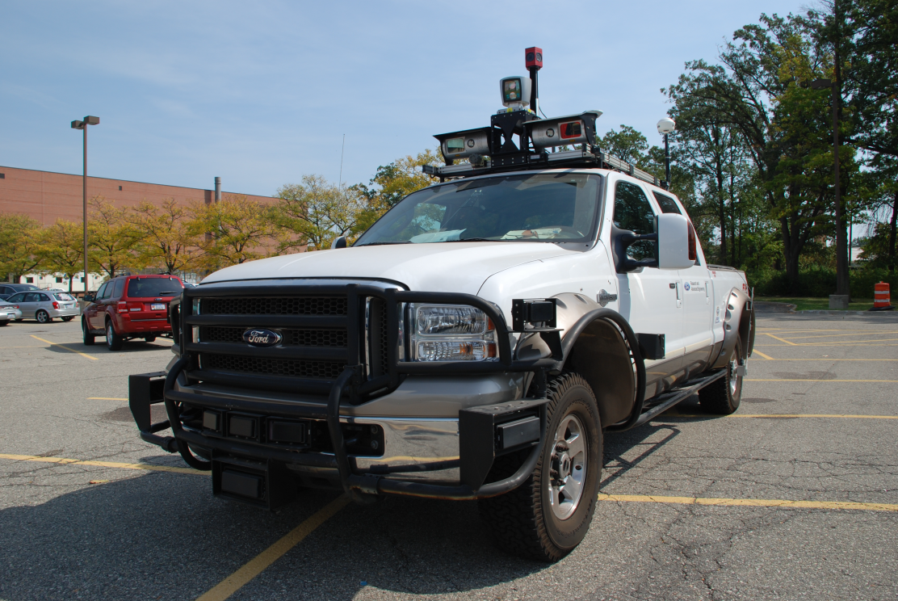
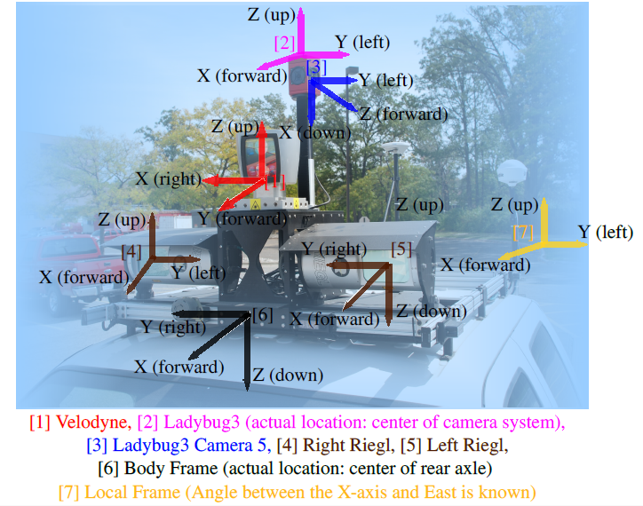

Slide 2
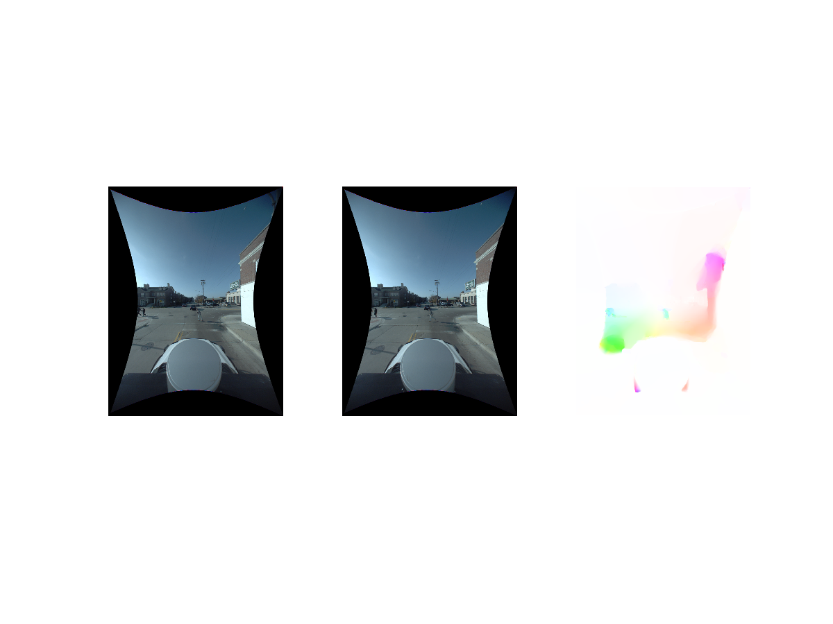
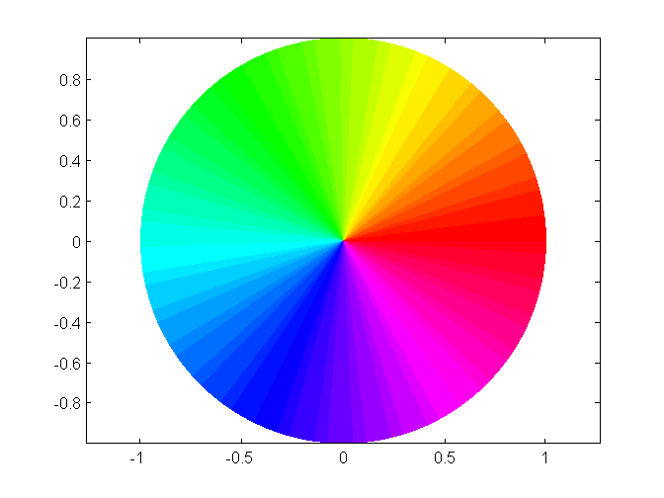
Frame 1
Frame 2
Optical Flow

Slide 3
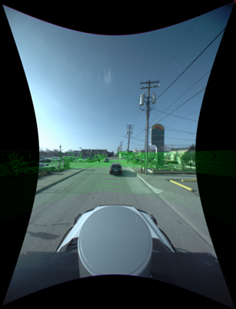

Slide 4
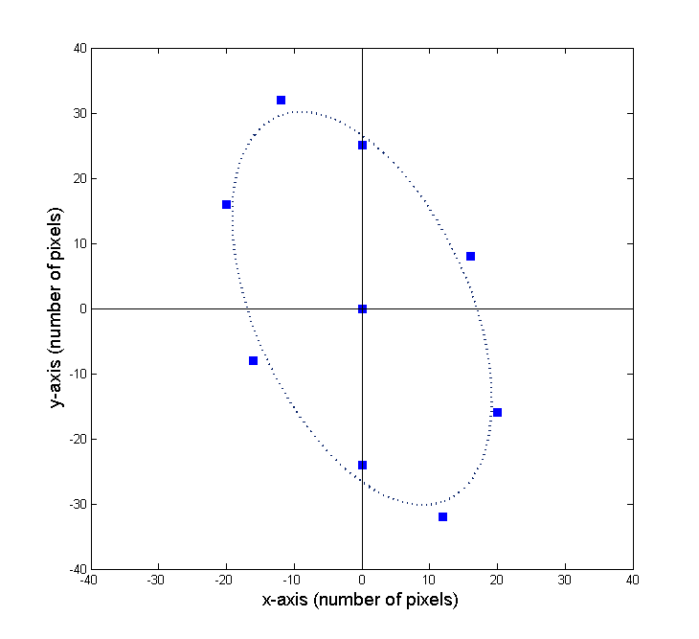
CLASS 2 [x:-12 ,y:32]
CLASS 3 [x:0 ,y:24]
CLASS 9 [x:-20 ,y:16]
CLASS 4 [x16: ,y:8]
CLASS 8 [x:-16 ,y:-8]
CLASS 1 [x:0 ,y:0]
CLASS 7 [x:0 ,y:25]
CLASS 5 [x:20 ,y:-16]
CLASS 6 [x:12 ,y:-32]

Slide 5
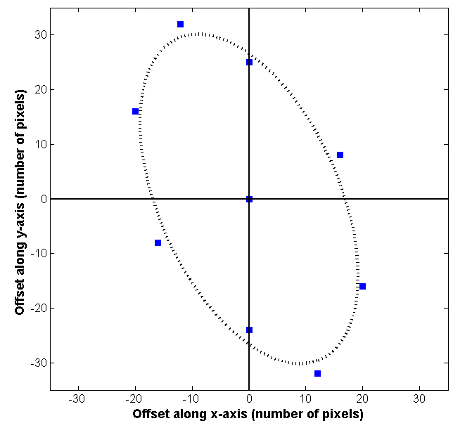
CLASS 2 [x:-12 ,y:32]
CLASS 9 [x:-20 ,y:16]
CLASS 3 [x:0 ,y:24]
CLASS 4 [x16: ,y:8]
CLASS 1 [x:0 ,y:0]
CLASS 8 [x:-16 ,y:-8]
CLASS 5 [x:20 ,y:-16]
CLASS 7 [x:0 ,y:25]
CLASS 6 [x:12 ,y:-32]

Slide 6
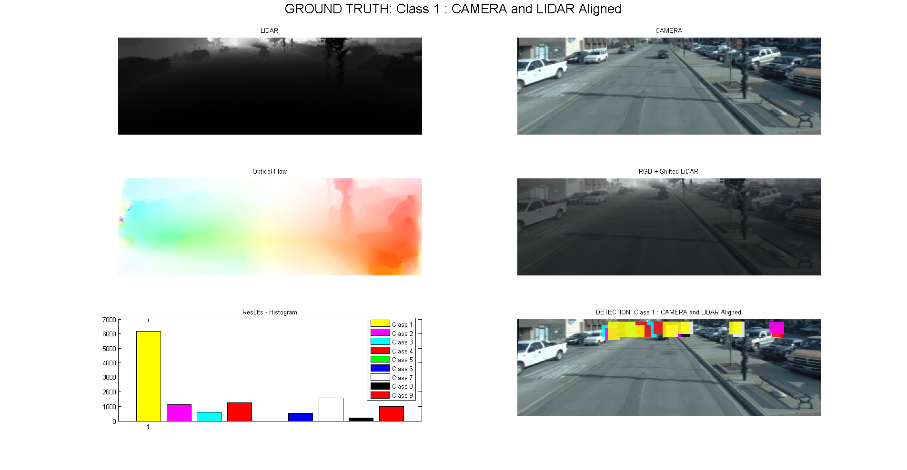
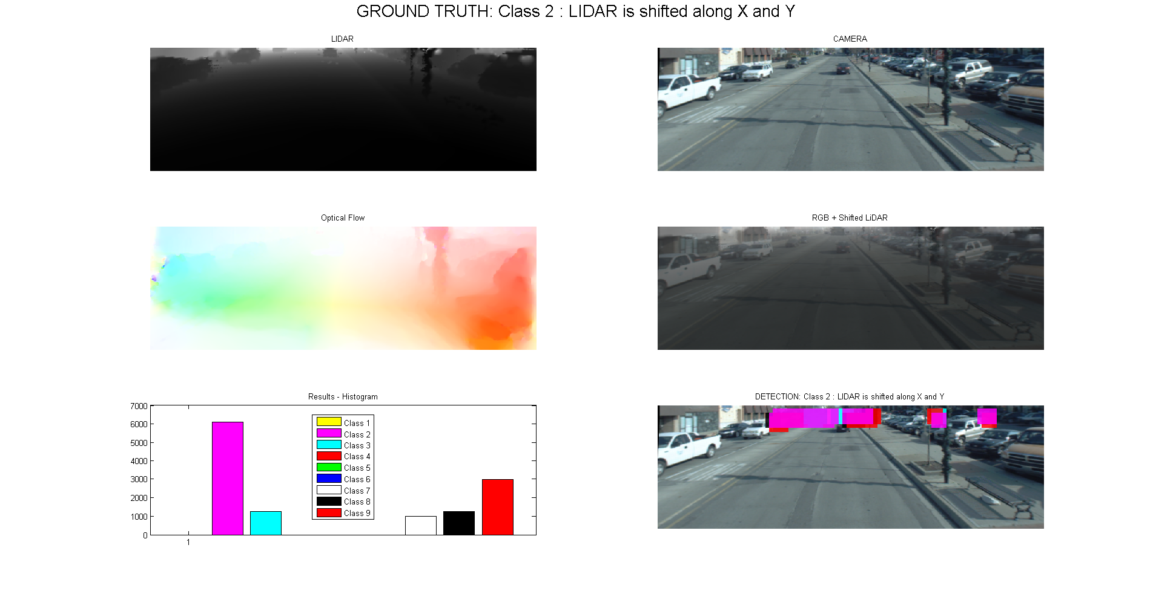
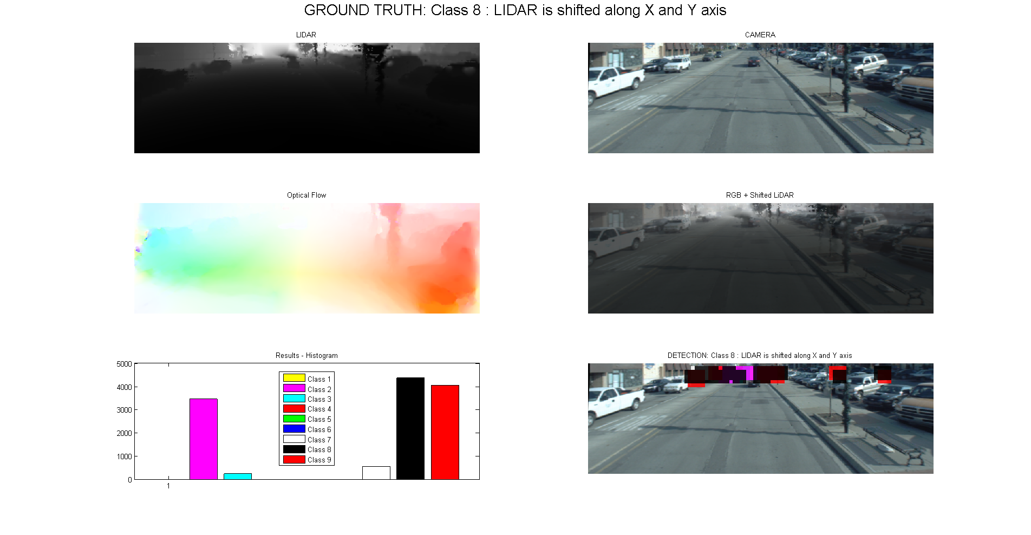
CLASS 1
CLASS 2 [x:-12 ,y:32]
CLASS 3 [x:0 ,y:24]
CLASS 9 [x:-20 ,y:16]
CLASS 2
CLASS 4 [x16: ,y:8]
CLASS 8 [x:-16 ,y:-8]
CLASS 1 [x:0 ,y:0]
CLASS 7 [x:0 ,y:25]
CLASS 5 [x:20 ,y:-16]
CLASS 8
CLASS 6 [x:12 ,y:-32]

Slide 7
CLASS 1
CLASS 2 [x:-12 ,y:32]
CLASS 3 [x:0 ,y:24]
CLASS 9 [x:-20 ,y:16]
CLASS 2
CLASS 4 [x16: ,y:8]
CLASS 8 [x:-16 ,y:-8]
CLASS 1 [x:0 ,y:0]
CLASS 7 [x:0 ,y:25]
CLASS 5 [x:20 ,y:-16]
CLASS 8
CLASS 6 [x:12 ,y:-32]

Slide 8
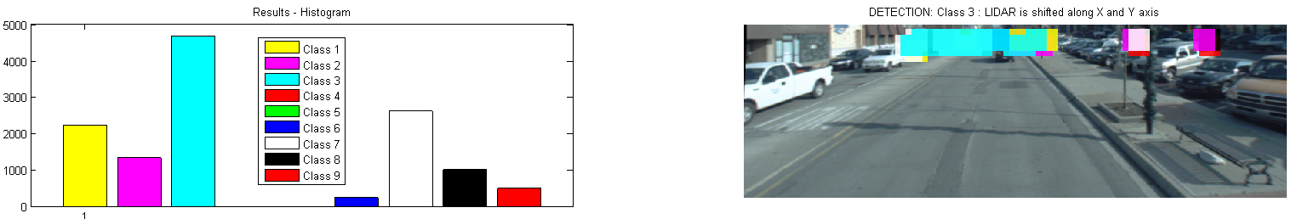
Ground truth: CLASS 1
CLASS 1
Ground truth: CLASS 3
CLASS 3

